Slide 1

Retro Pie Project
By Jon Franck

Slide 2
What You Need To Get Started:
Raspberry Pi with SD card
Some sort of monitor with HDMI cord
Keyboard/Mouse/Controller
Another computer to download software and ROMS from
A USB Drive to transfer ROMS
(I also HIGHLY recommend getting a case for your Raspberry Pi with a fan and multiple heat syncs, because depending on what games you plan on running, it will get quite hot)

Slide 3
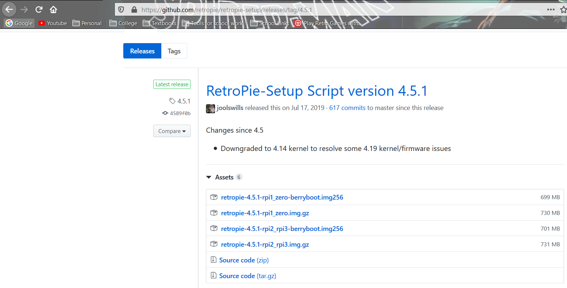
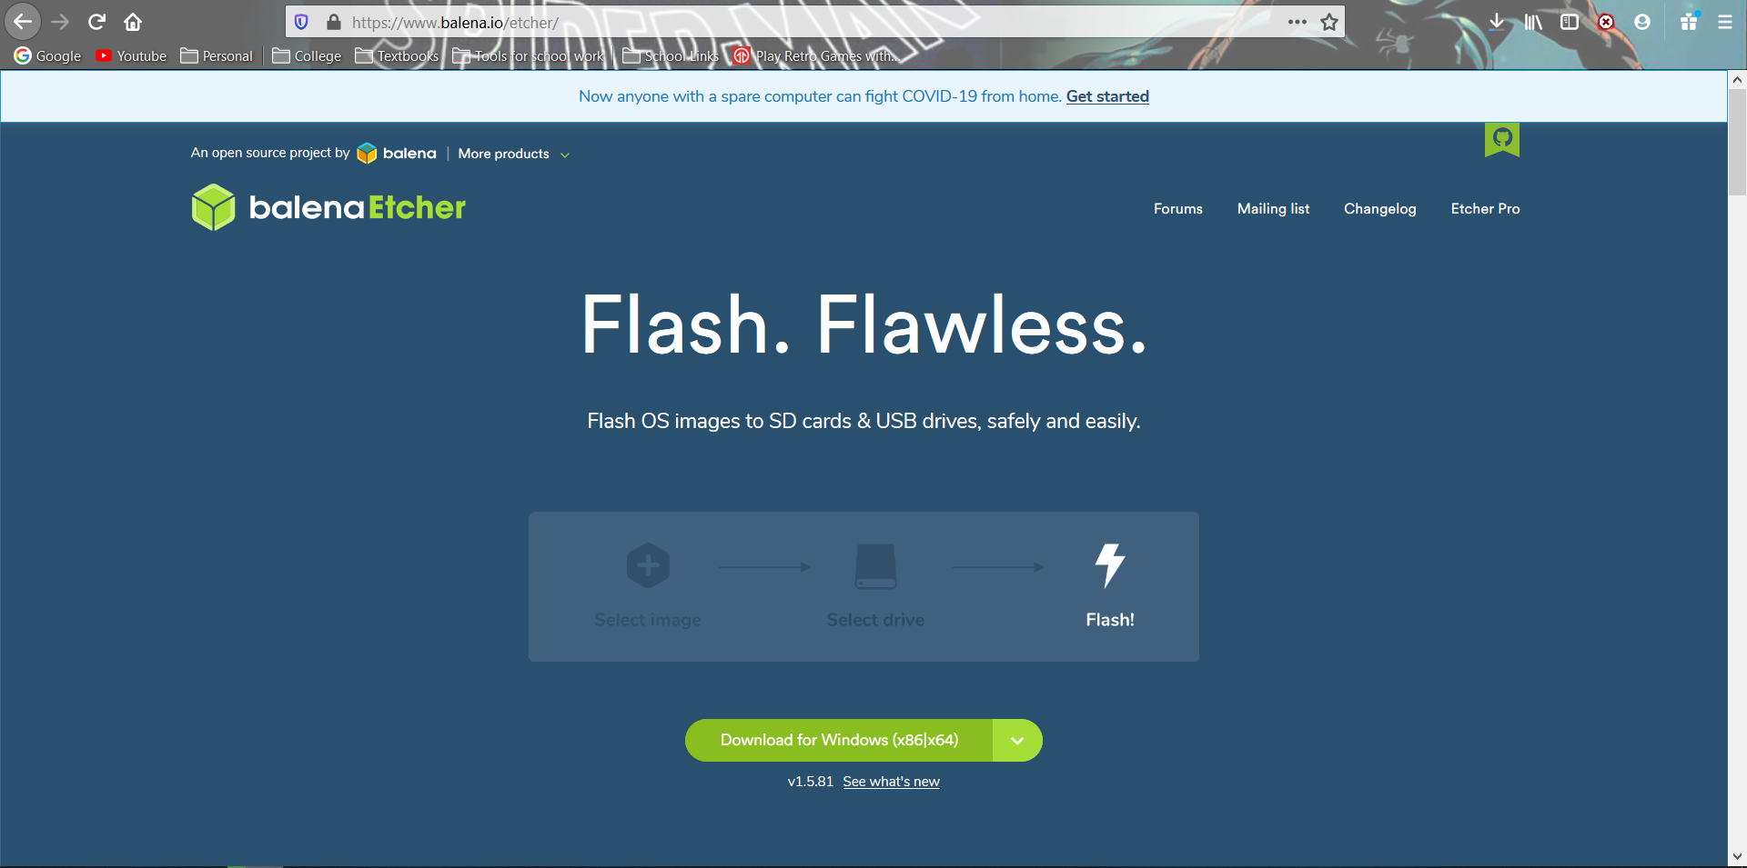
Downloads:
Go to https://www.github.com/retropie/retropie-setup/releases/latest and download the setup that corresponds to the raspberry pi you have (for the Raspberry Pi 3 and up it is the one circled in red)
You will also need to go to https://www.balena.io/etcher and download the Etcher setup file for your operating system

Slide 4
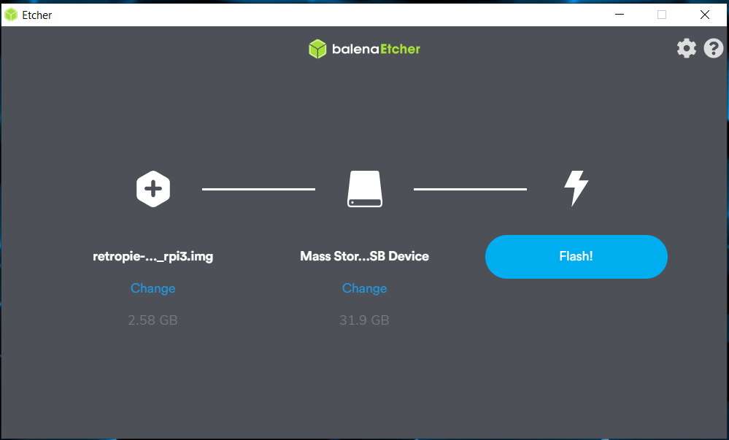
Using Etcher:
Run Etcher after it is installed. Simply select the RetroPie pre-built image you just downloaded.
You will also need to insert your SD card into the computer, and it should automatically select it in Etcher.
Then click Flash to begin setup
(NOTE: This will erase all data on your SD card in order to install the RetroPie image)

Slide 5
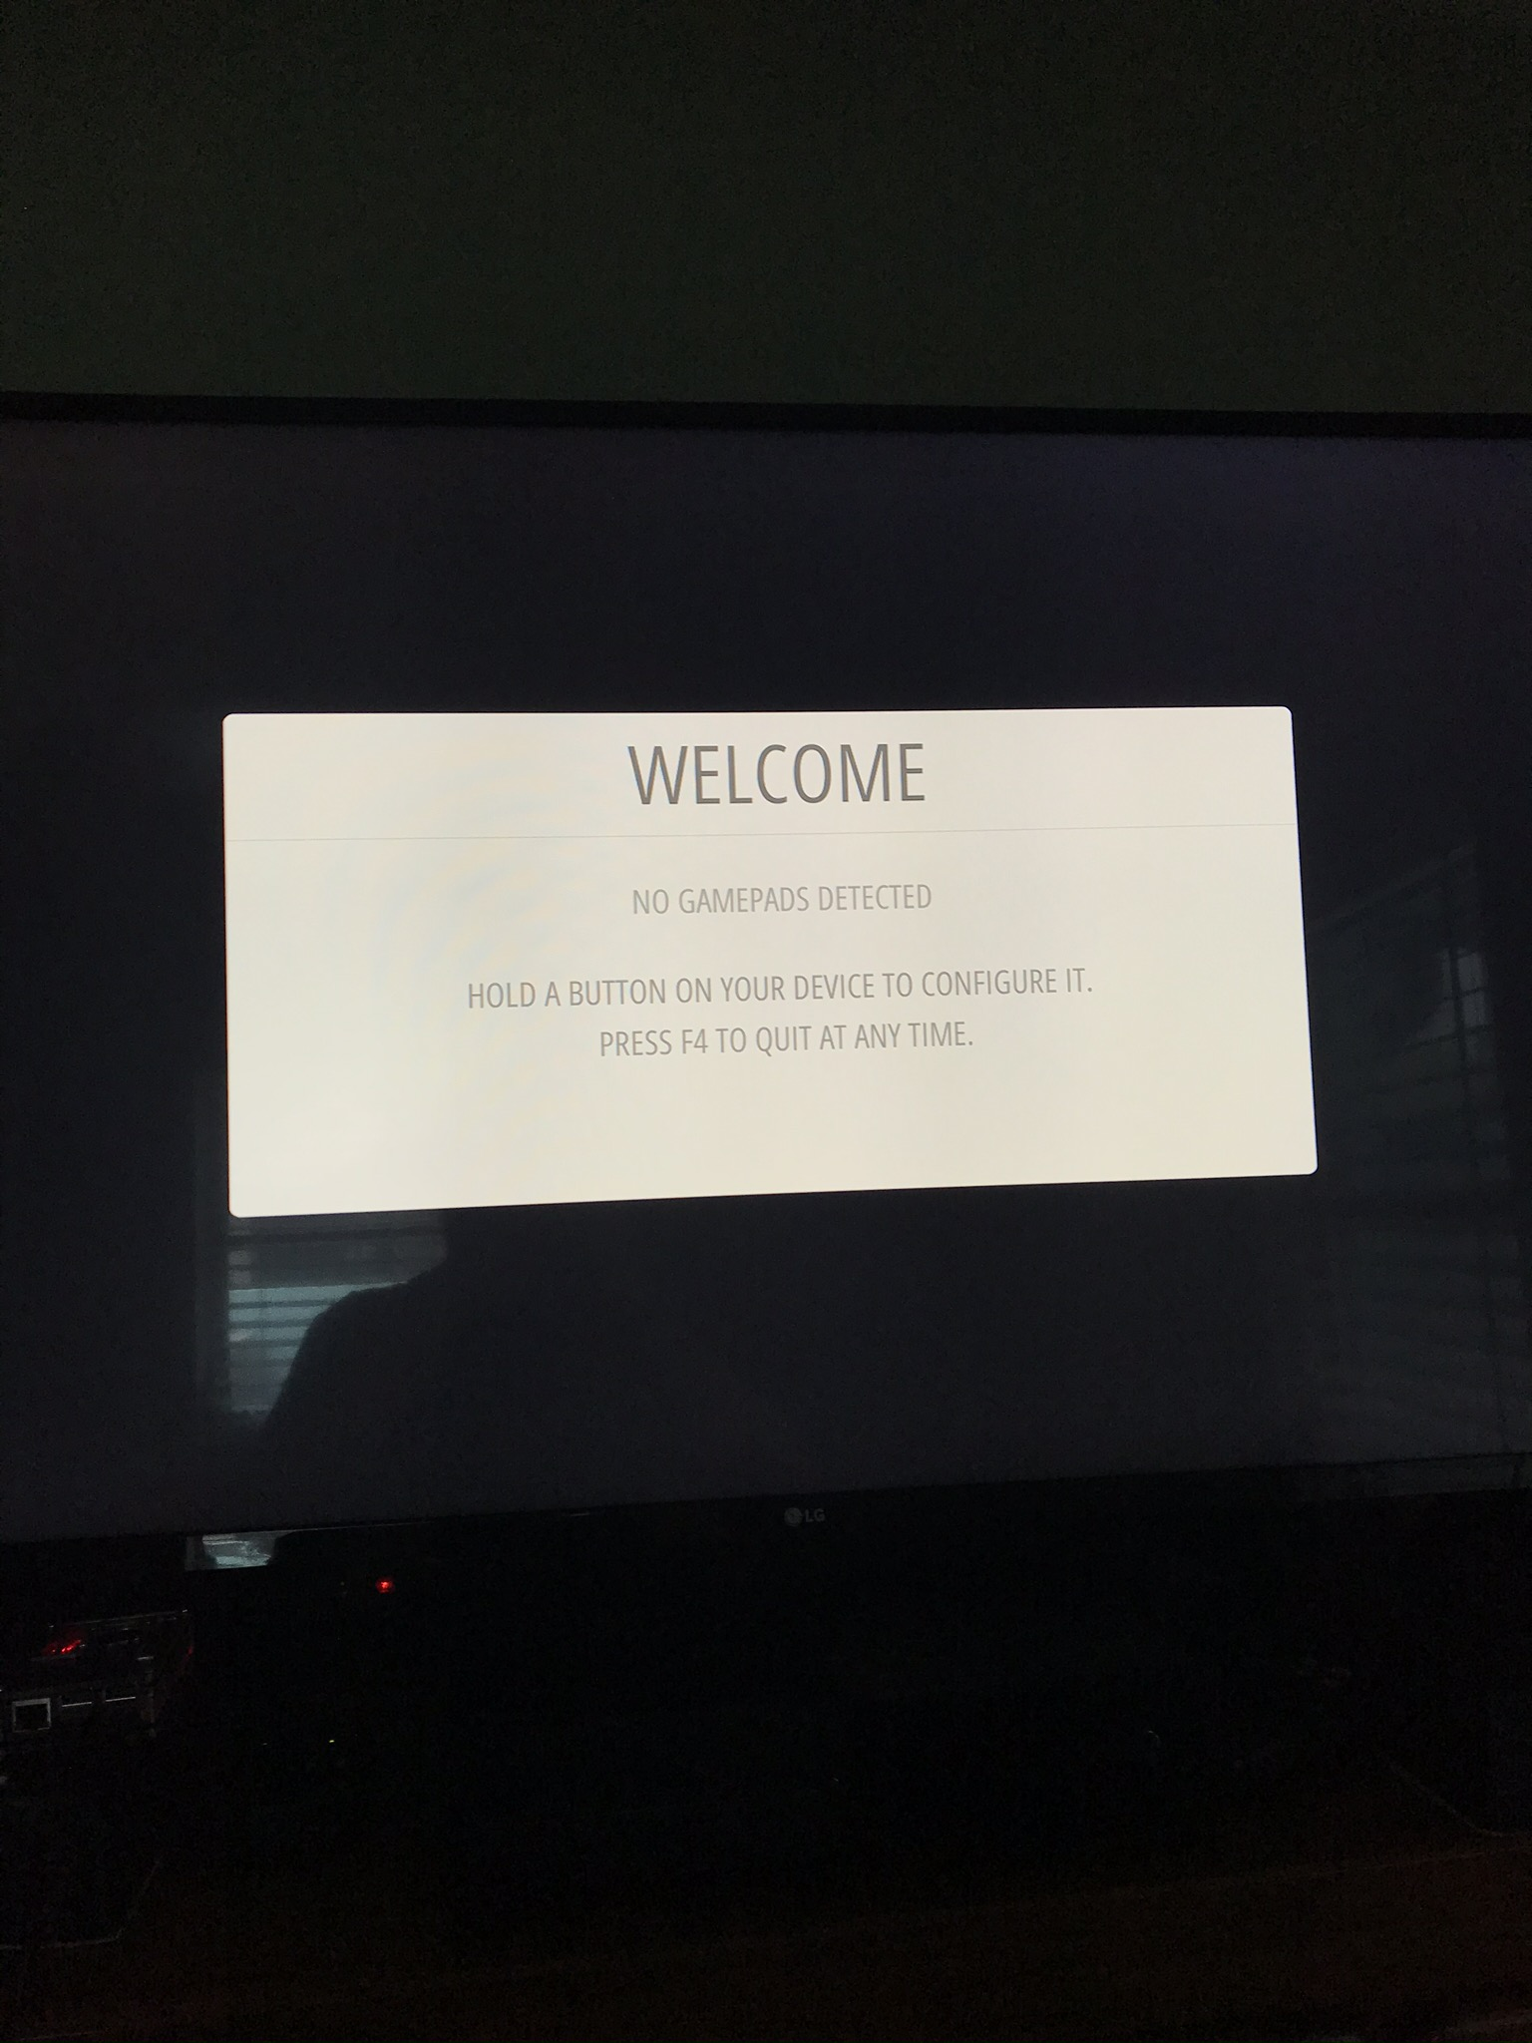
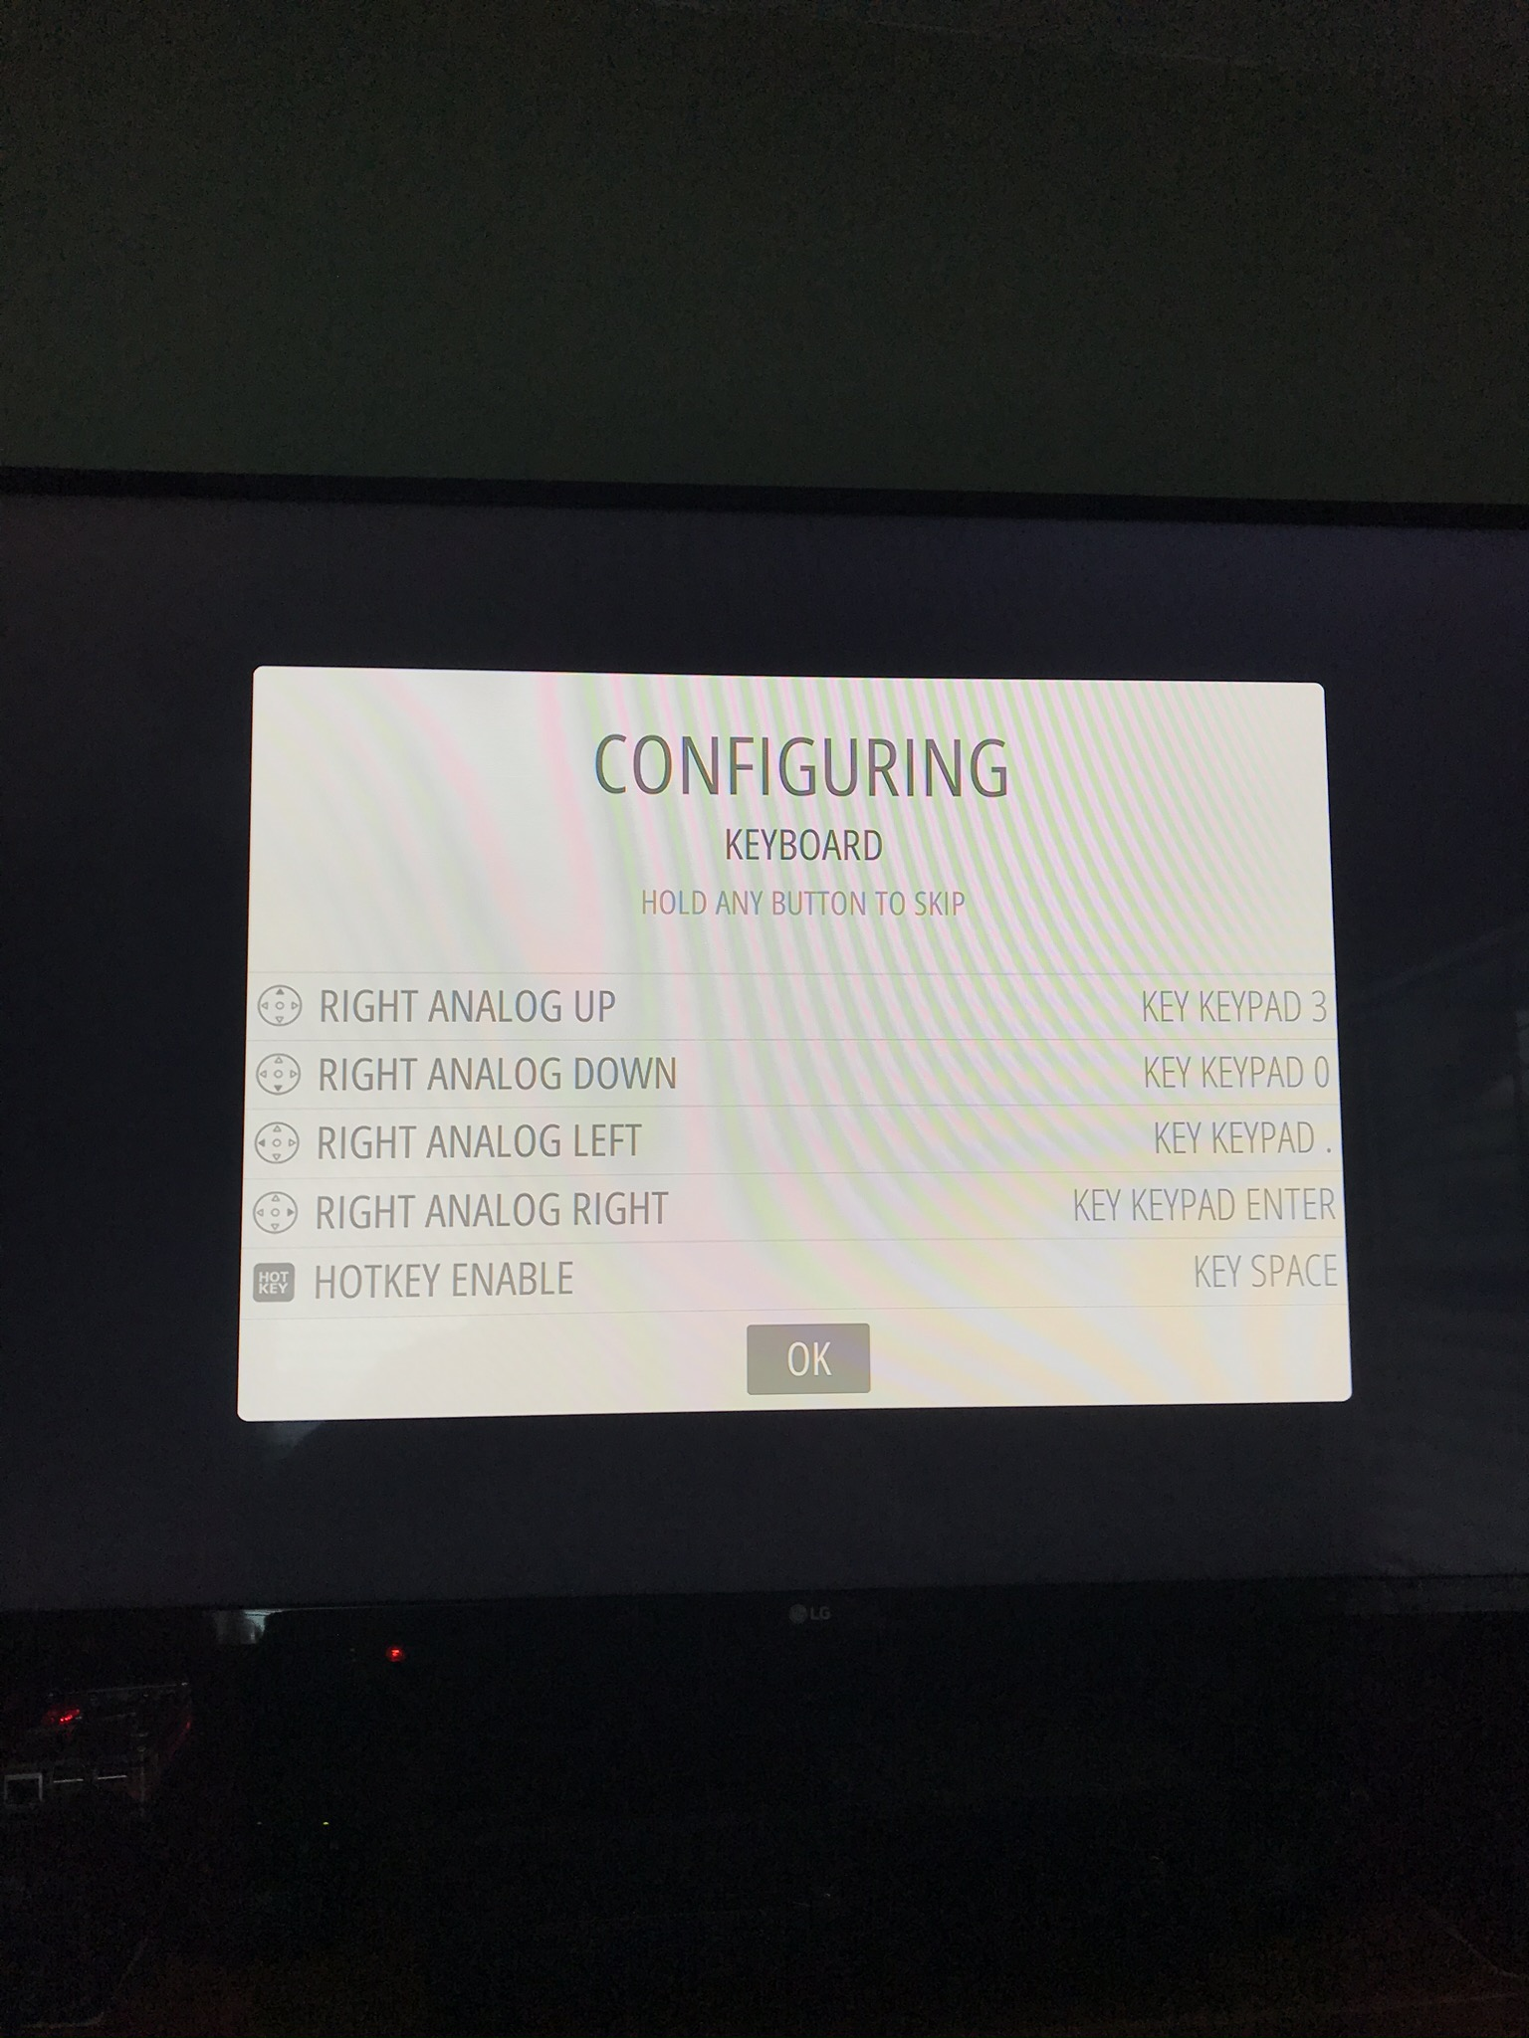
Boot up Your Retro Pie
The first time you turn on your RetroPie, you will have to configure the controls
(You can reconfigure this at any time)

Slide 6
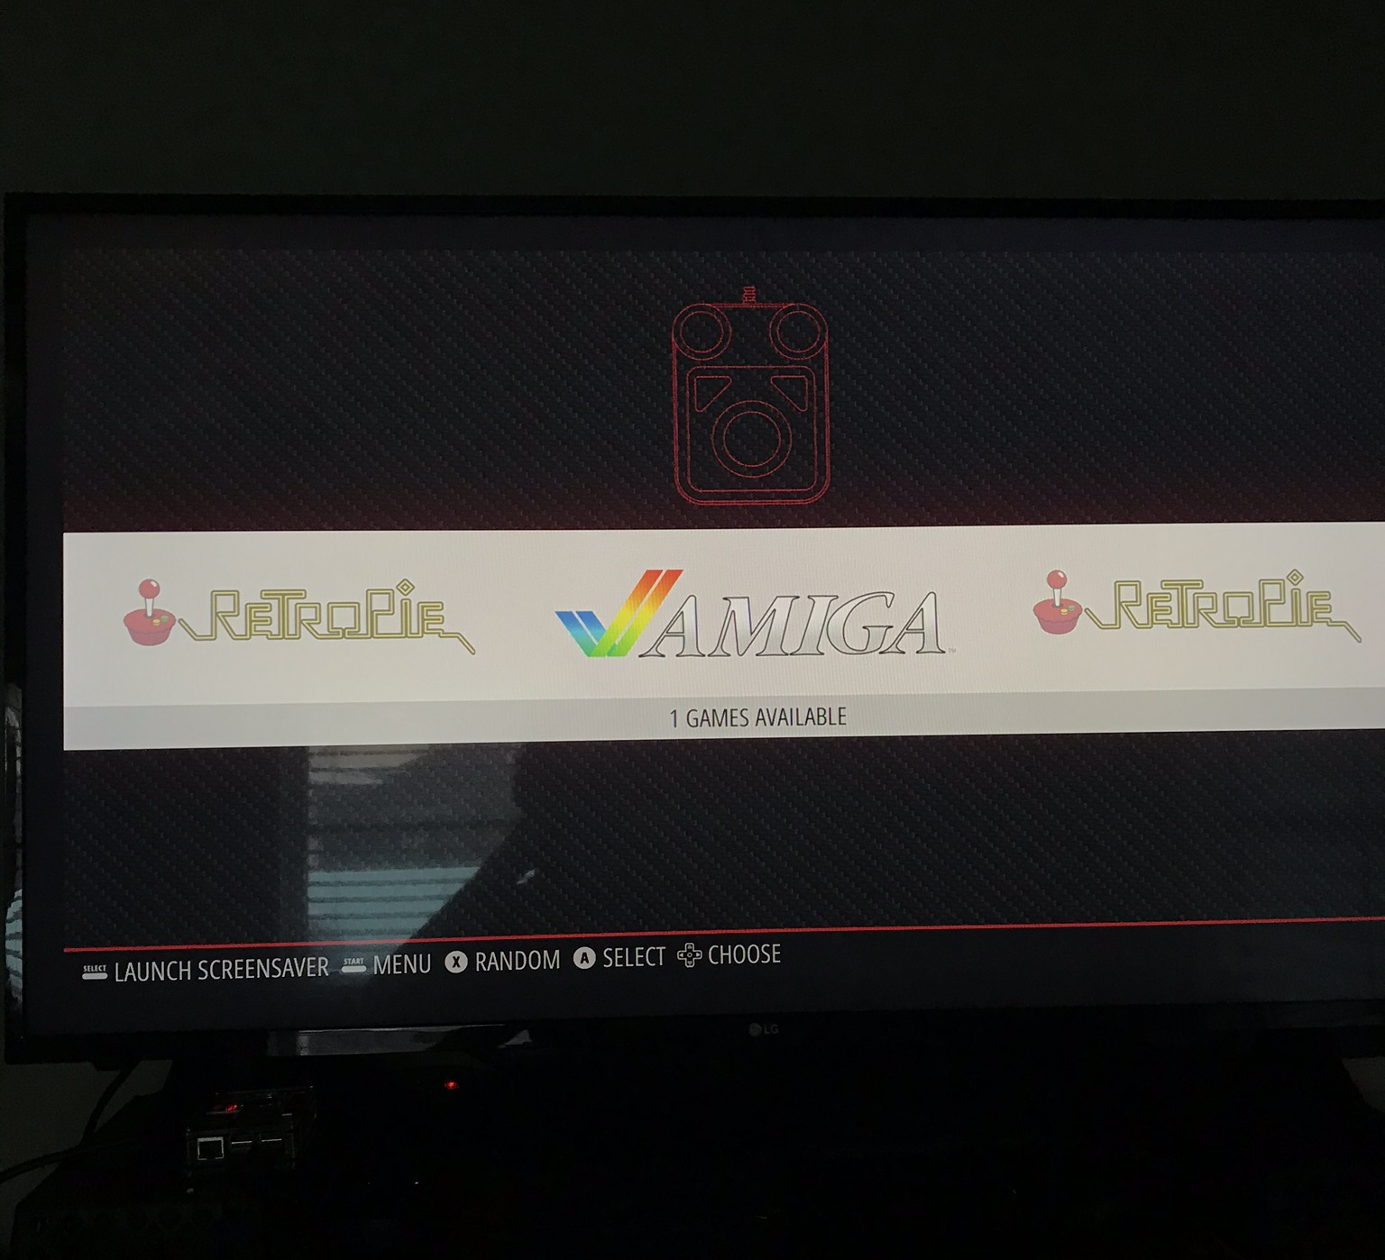
Welcome To Your RetroPie
Now we just need to add some ROMS (the game files)…

Slide 7
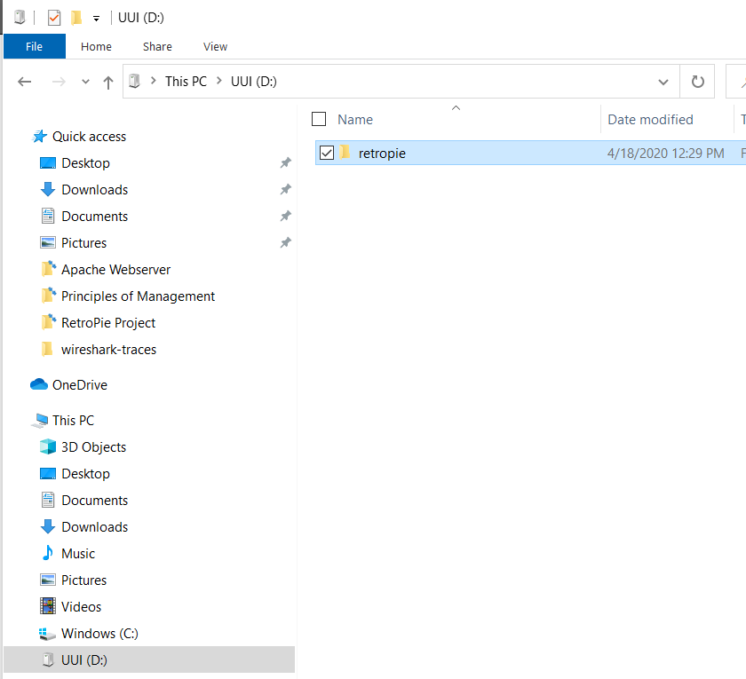
Setup your USB
Create a file on a USB drive named “retropie” (the RetroPie will recognize and configure this directory)
Insert the USB drive into your RetroPie and wait about 2-3 mins
Then put the USB back into your other computer

Slide 8
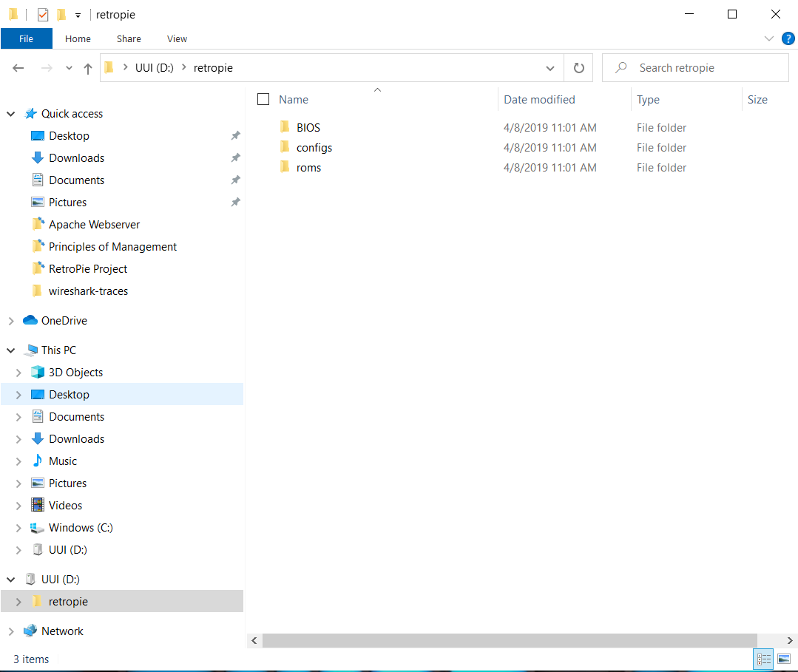
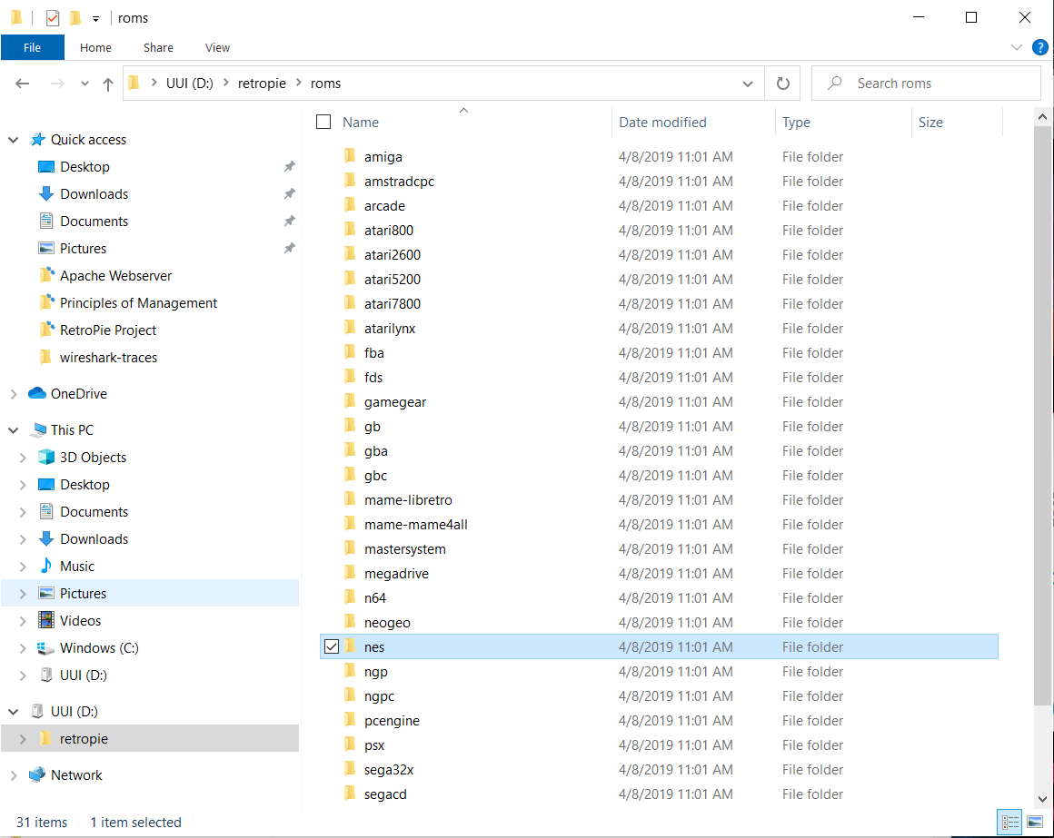
CHECK The Directories
Once your USB drive is in your computer double check that it configured correctly
Make sure that the “retropie” folder contains the following:
BIOS, configs, and roms
The roms directory should be full of folders for different retro consoles

Slide 9
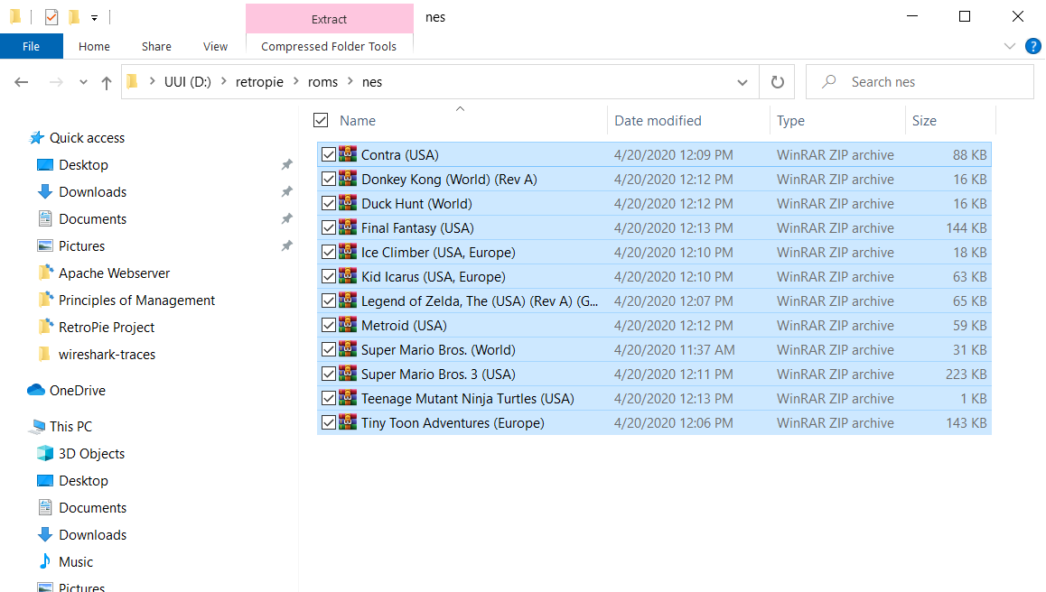
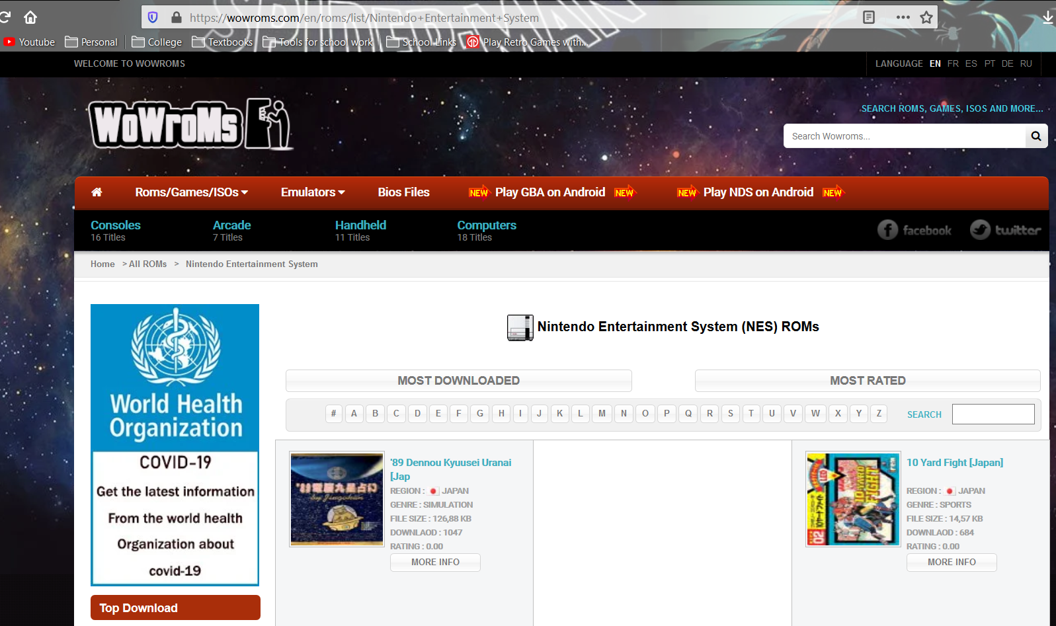
Download Game Roms
You can find tons of site with free ROMS on Google. I used wowroms.com
Once they download, copy them to the correct file inside the “retropie” directory (mine were all for the NES)
(NOTE: You don’t have to extract them)

Slide 10
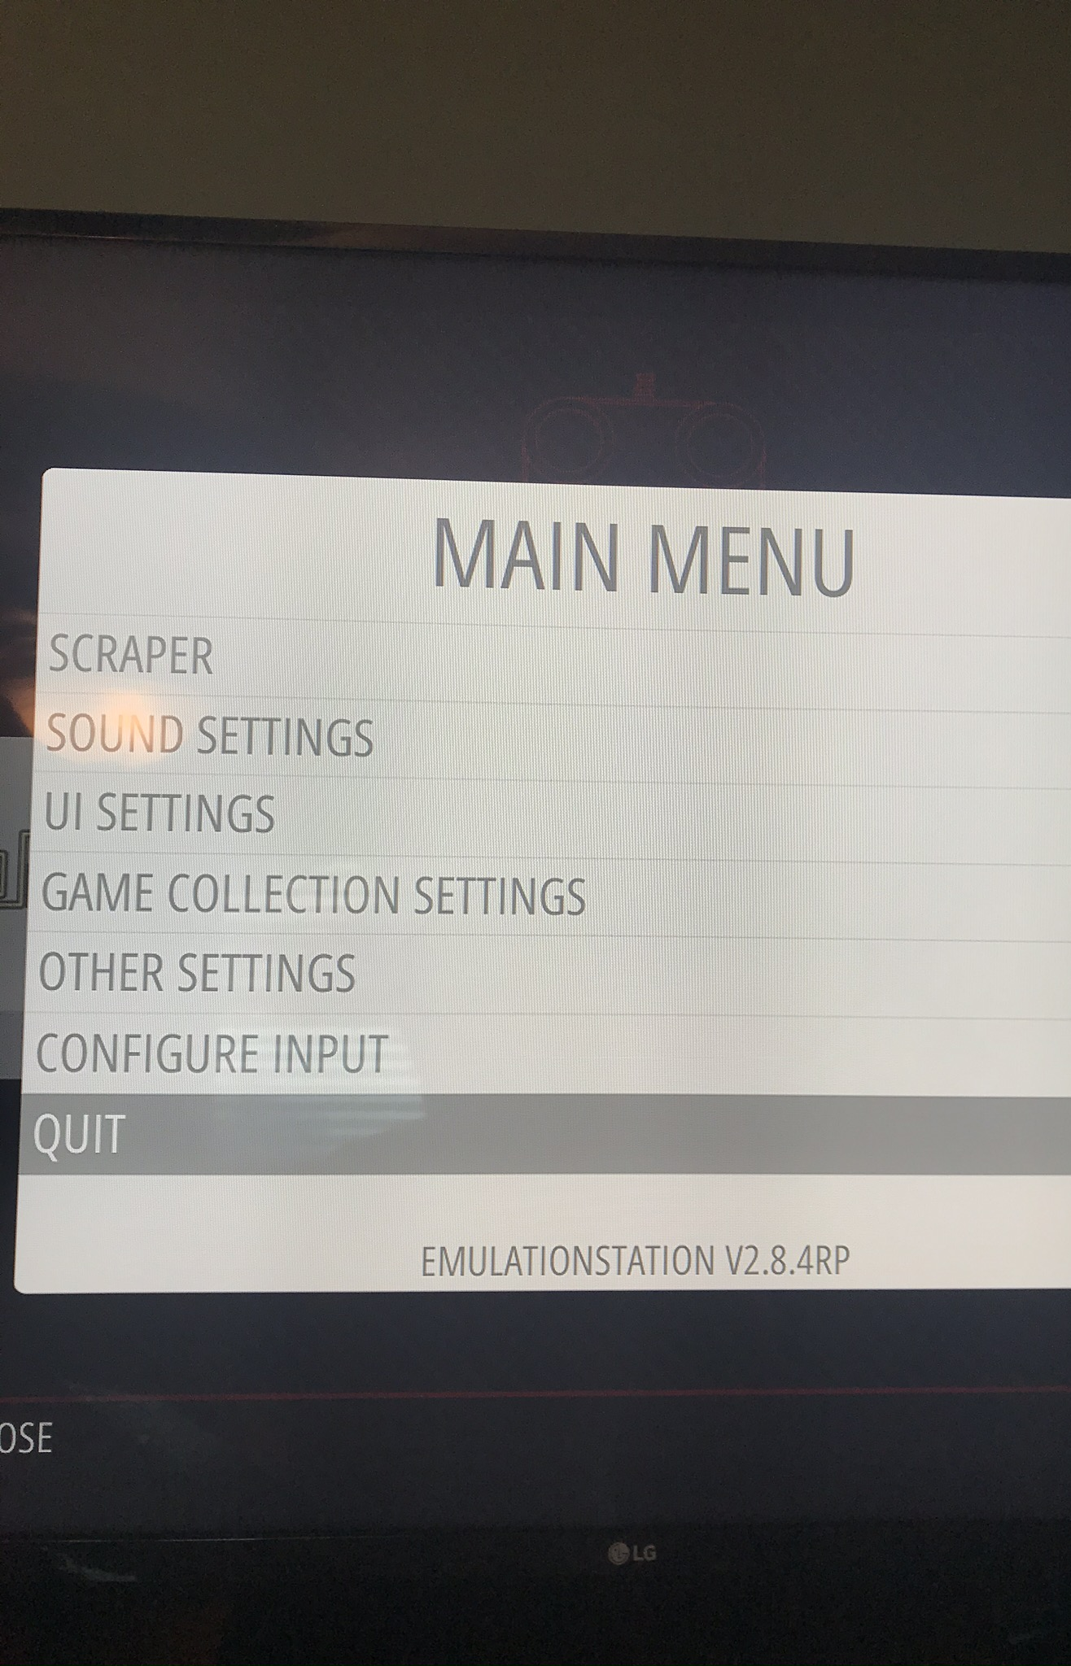
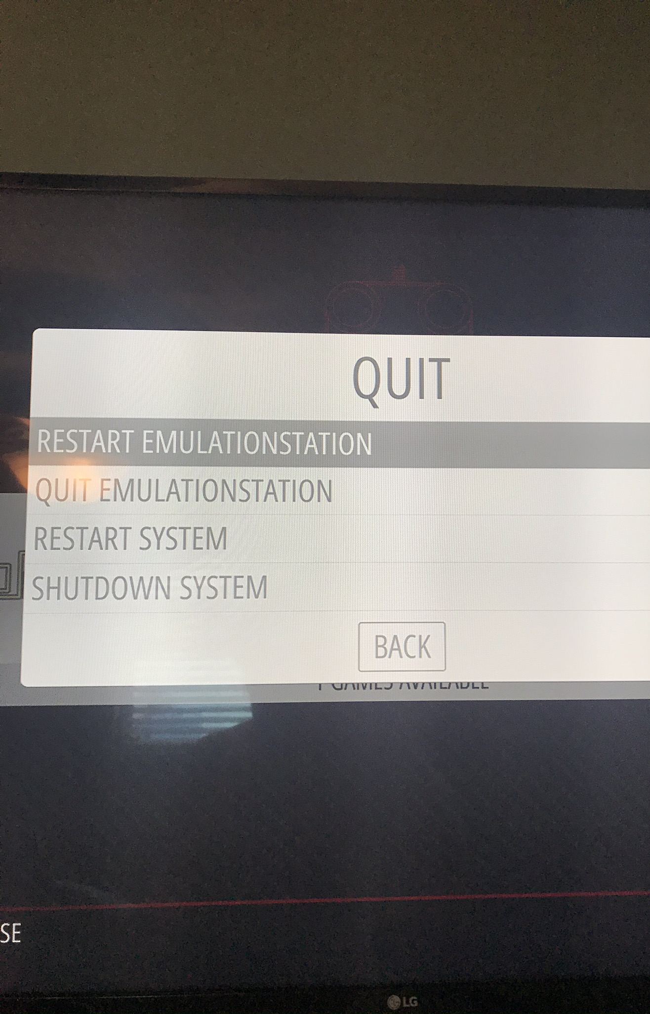
Copy the ROMS to Your Retropie
Put your USB back into the RetroPie and wait a few more minutes for the files to copy
Then restart the EmulationStation

Slide 11
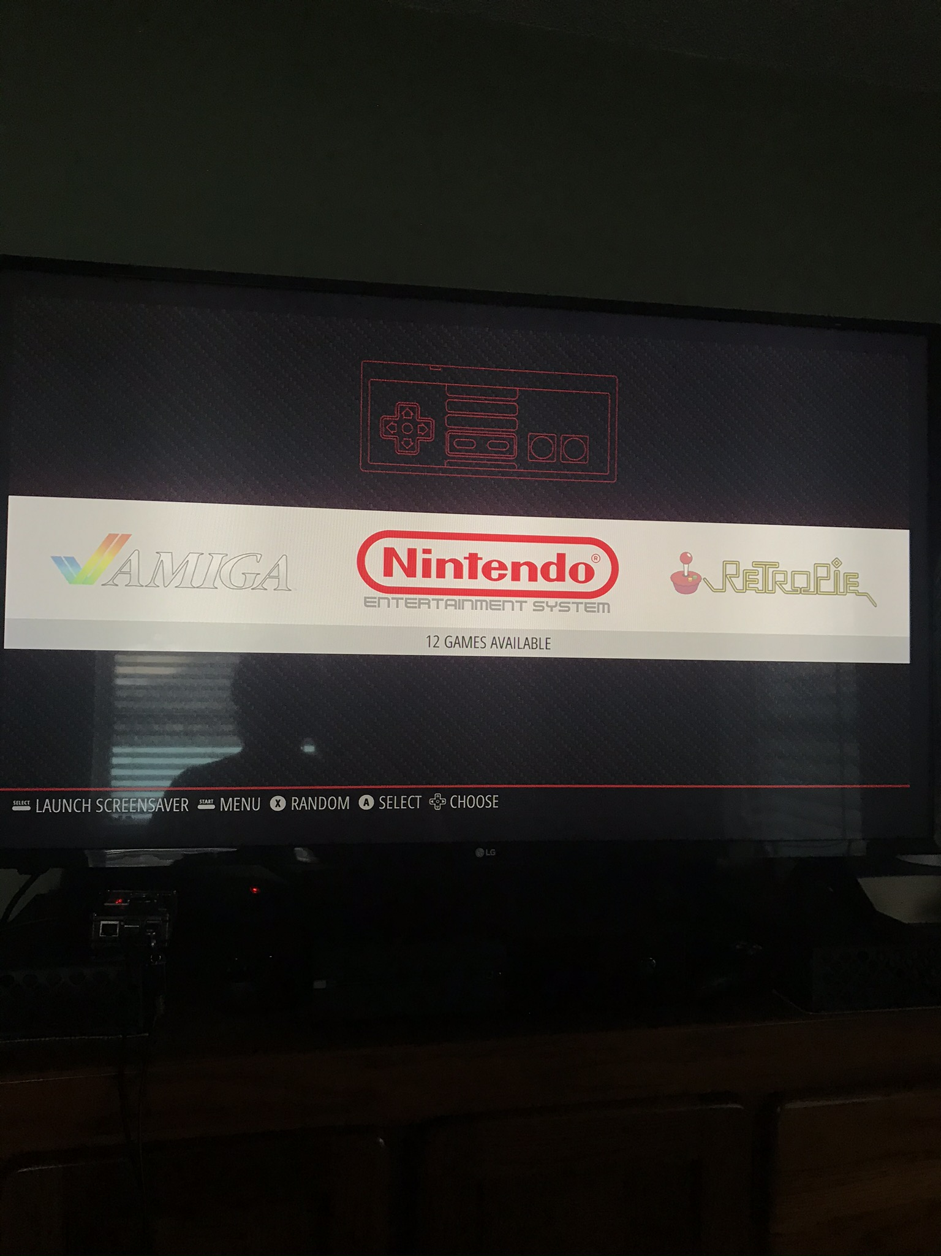
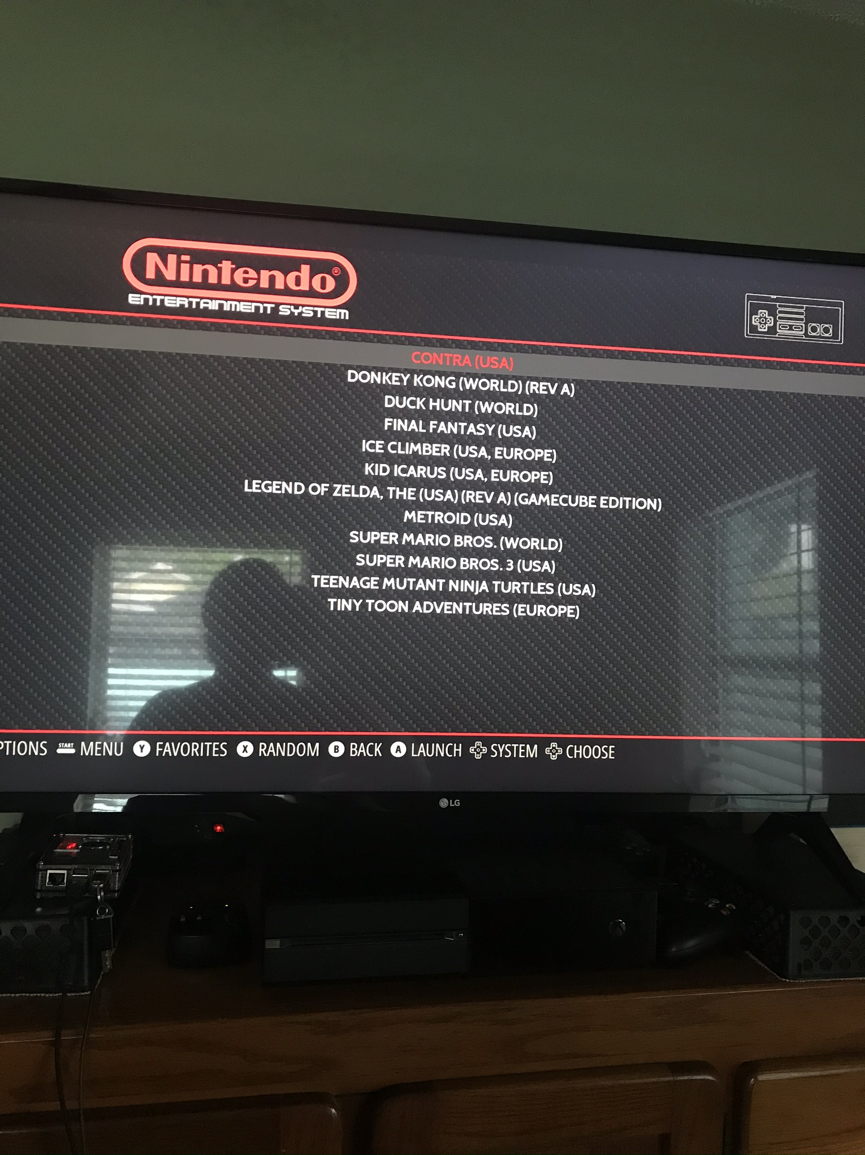
your new emulator and games

Slide 12
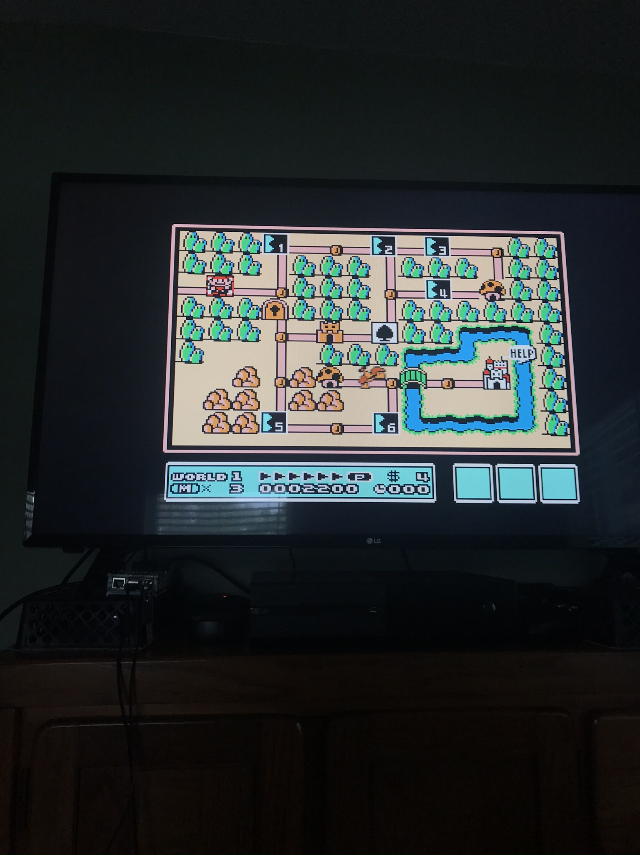

Enjoy your games

